Slide 1
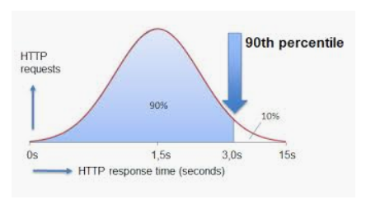
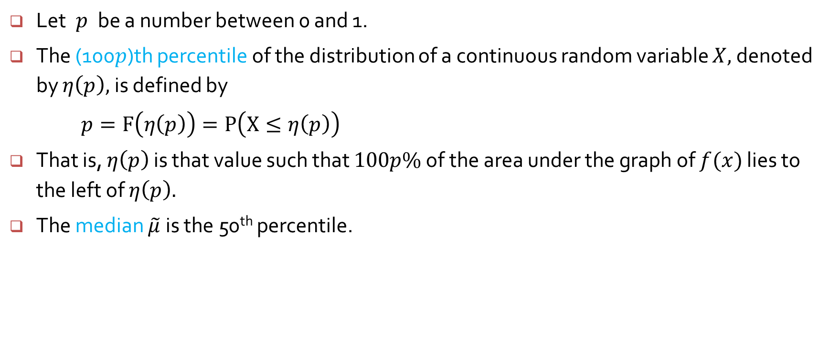
Percentiles of a continuous distribution
Let$p$ be a number between 0 and 1.
The (100$p$)th percentile of the distribution of a continuous random variable $X,$denoted by $η\left(p\right),$ is defined by
$p=F\left(η\left(p\right)\right)=P\left(X≤η\left(p\right)\right)$
That is, $η\left(p\right)$ is that value such that $100p\%$ of the area under the graph of $f(x)$ lies to the left of $η\left(p\right).$
The median $\tilde{μ}$is the 50th percentile.

Slide 2
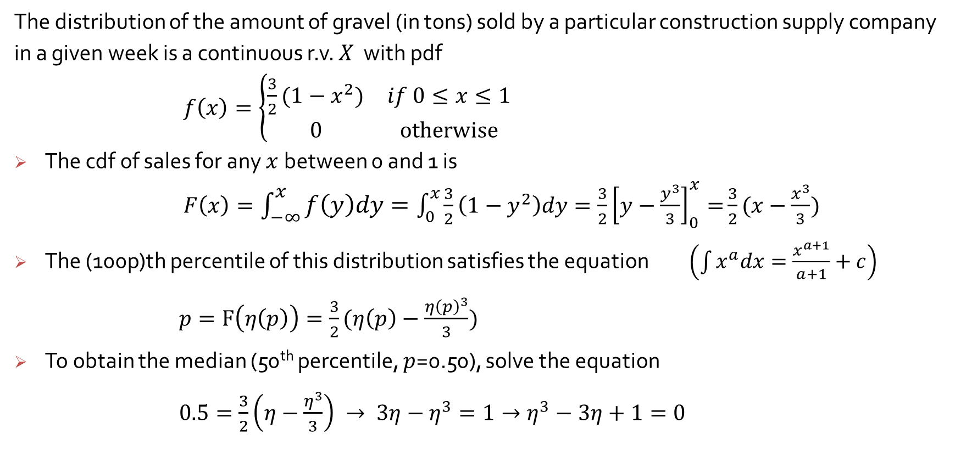
Example 4.9
The distribution of the amount of gravel (in tons) sold by a particular construction supply company in a given week is a continuous r.v. $X$ with pdf
$f\left(x\right)=\left\{\begin{matrix}\frac{3}{2}(1−x^{2}) & if 0≤x≤1 \\ 0 & otherwise\end{matrix}\right.$
The cdf of sales for any $x$between 0 and 1 is
$F\left(x\right)=\int_{−∞}^{x}{f\left(y\right)dy}=\int_{0}^{x}{\frac{3}{2}\left(1−y^{2}\right)dy=\frac{3}{2}{\left[y−\frac{y^{3}}{3}\right]}_{0}^{x}=}\frac{3}{2}(x−\frac{x^{3}}{3})$
The (100p)th percentile of this distribution satisfies the equation $\left(\int{x^{a}dx=\frac{x^{a+1}}{a+1}+c}\right)$
$p=F\left(η\left(p\right)\right)=\frac{3}{2}(η\left(p\right)−\frac{{η\left(p\right)}^{3}}{3})$
To obtain the median (50th percentile, $p$=0.50), solve the equation
$0.5=\frac{3}{2}\left(η−\frac{η^{3}}{3}\right) → 3η−η^{3}=1→η^{3}−3η+1=0$

Slide 3
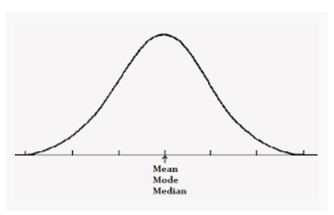
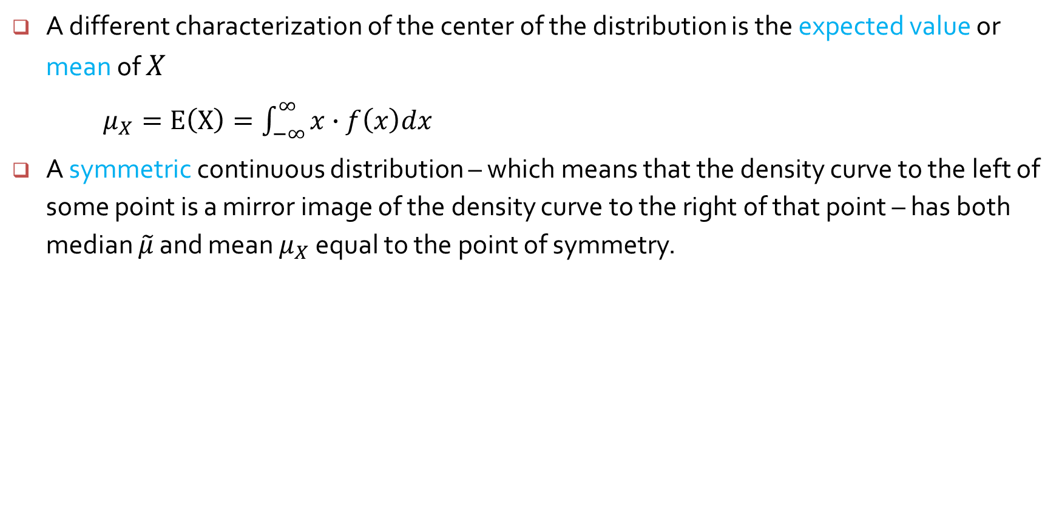
Mean of a continuous random variable
A different characterization of the center of the distribution is the expected value or mean of $X$
$μ_{X}=E\left(X\right)=\int_{−∞}^{∞}{x∙f\left(x\right)dx}$
A symmetric continuous distribution – which means that the density curve to the left of some point is a mirror image of the density curve to the right of that point – has both median $\tilde{μ}$ and mean $μ_{X}$ equal to the point of symmetry.

Slide 4
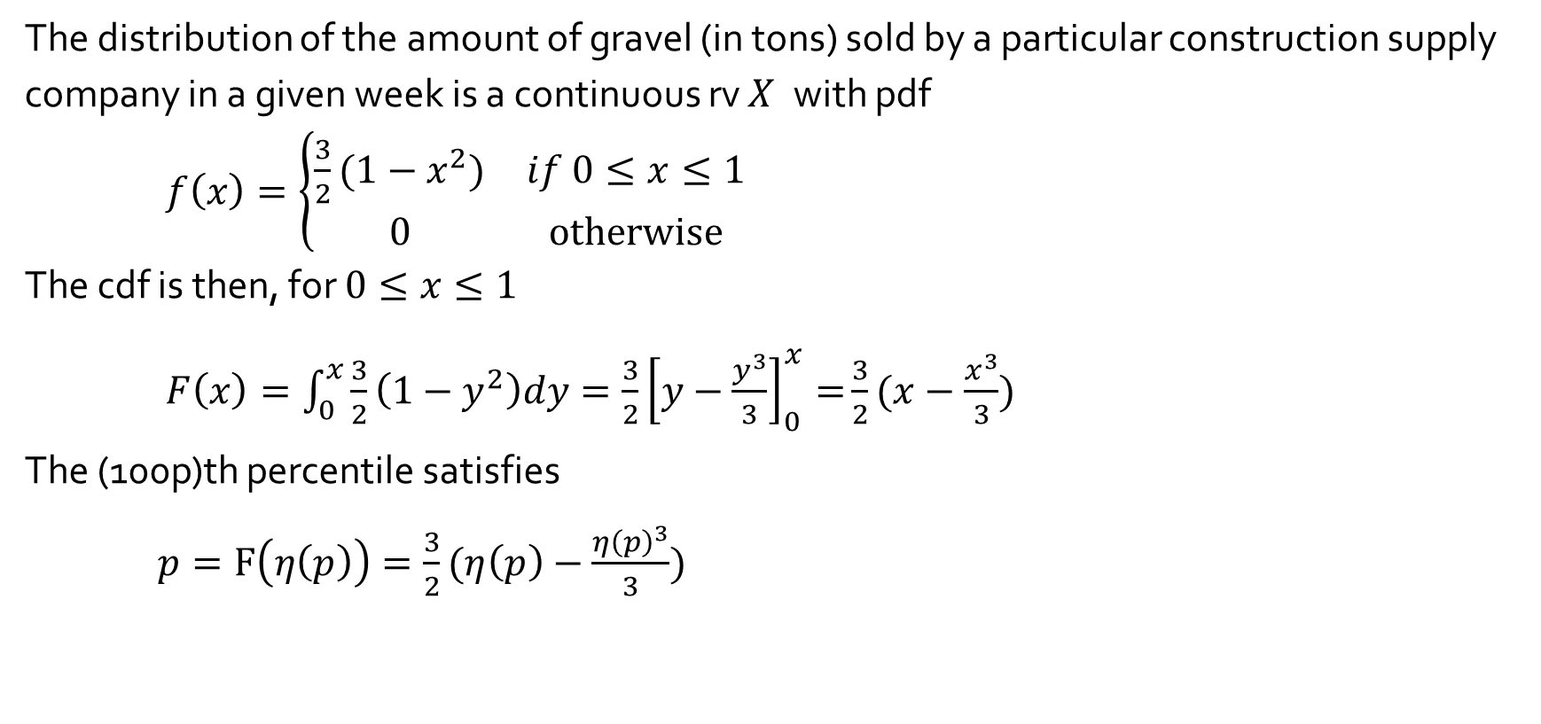
Example 4.9
The distribution of the amount of gravel (in tons) sold by a particular construction supply company in a given week is a continuous rv $X$ with pdf
$f\left(x\right)=\left\{\begin{matrix}\frac{3}{2}(1−x^{2}) & if 0≤x≤1 \\ 0 & otherwise\end{matrix}\right.$
The cdf is then, for $0≤x≤1$
$F\left(x\right)=\int_{0}^{x}{\frac{3}{2}\left(1−y^{2}\right)dy=\frac{3}{2}{\left[y−\frac{y^{3}}{3}\right]}_{0}^{x}=}\frac{3}{2}(x−\frac{x^{3}}{3})$
The (100p)th percentile satisfies
$p=F\left(η\left(p\right)\right)=\frac{3}{2}(η\left(p\right)−\frac{{η\left(p\right)}^{3}}{3})$

Slide 5
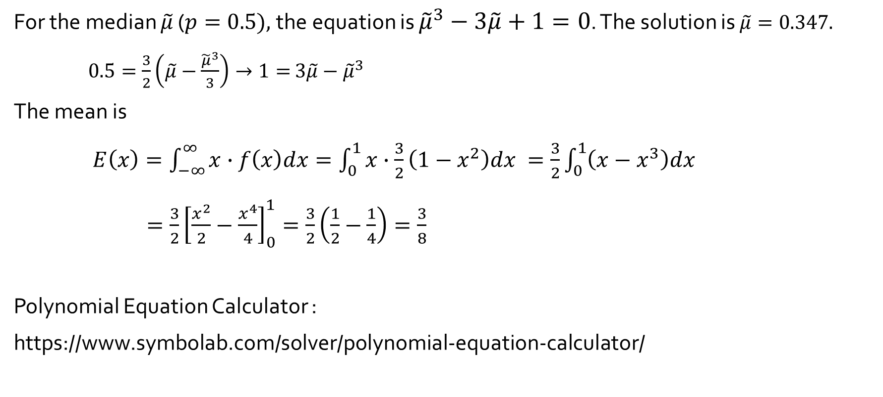
Example 4.9 (cont’d)
For the median $\tilde{μ}$ ($p=0.5),$the equation is ${\tilde{μ}}^{3}−3\tilde{μ}+1=0$. The solution is $\tilde{μ}=0.347.$
$0.5=\frac{3}{2}\left(\tilde{μ}−\frac{{\tilde{μ}}^{3}}{3}\right)→1=$ $3\tilde{μ}−{\tilde{μ}}^{3}$
The mean is
$E\left(x\right)=\int_{−∞}^{∞}{x∙f\left(x\right)dx}=\int_{0}^{1}{x∙\frac{3}{2}\left(1−x^{2}\right)dx }=\frac{3}{2}\int_{0}^{1}{\left(x−x^{3}\right)dx }$
$=\frac{3}{2}{\left[\frac{x^{2}}{2}−\frac{x^{4}}{4}\right]}_{0}^{1}=\frac{3}{2}\left(\frac{1}{2}−\frac{1}{4}\right)=\frac{3}{8}$
Polynomial Equation Calculator :
https://www.symbolab.com/solver/polynomial-equation-calculator/

Slide 6
Solving systems of nonlinear equations with Broyden or Newton
> install.packages("nleqslv")
> library(nleqslv)
> target <- function(x) {
+ z = x[1]^3-3*x[1]+1
+}
# Usage
> xstart <- c(0.1)
> nleqslv(xstart, target, method="Newton")
$x
[1] 0.3472964

